Slide 1
Lec 11: Convolution Integral
Dr. Arsla Khan

Slide 2
Convolution
Convolution operation is used to relate the input output relationship for LTI systems.
Importance of convolution stems from the fact that knowledge of response of an LTI system to the unit impulse input allows us to find its output to any input signals.
Convolution can be termed as
Convolution Integral → CT LTI Systems
Convolution Sum → DT LTI Systems

Slide 3
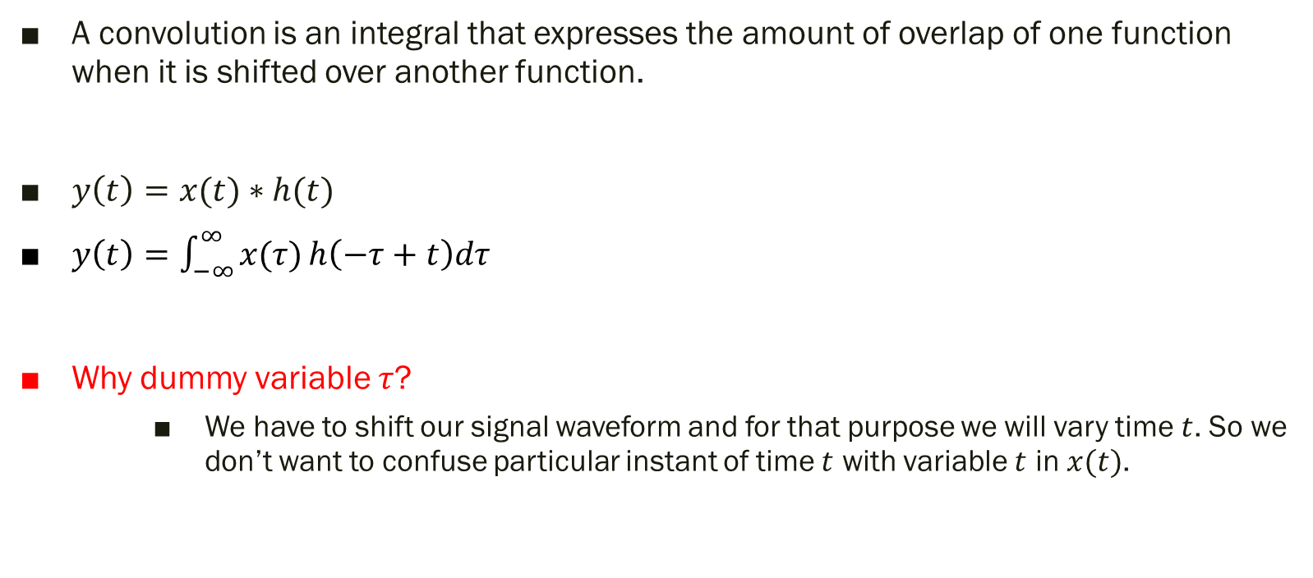
Convolution Integral
A convolution is an integral that expresses the amount of overlap of one function when it is shifted over another function.
$y\left(t\right)=x(t)∗h(t)$
$y\left(t\right)=\int_{−∞}^{∞}{x(τ)}h\left(−τ+t\right)dτ$
Why dummy variable $τ$?
We have to shift our signal waveform and for that purpose we will vary time $t$. So we don’t want to confuse particular instant of time $t$ with variable $t$ in $x(t)$.

Slide 4

Methods to find convolution integral
Formula :
Graphical / Formula approach

Slide 5

Steps to find Convolution Integral Using Formula
Folding: Convert $h(τ)$ into $h(−τ)$
Shifting: Fix $x(τ)$ and shift $h(−τ)$from right to left and convert it into $h(−τ+t)$
Multiplication: Multiply $x(τ)$ with$h(−τ+t)$
Integration: Integrate all products

Slide 6


Exp 1: Evaluate $x(t)$ and $h(t)$ by graphical/ formula technique
$x\left(t\right)=\left\{\begin{aligned}\begin{matrix}2 & for −2≤t≤2\end{matrix} \\ \begin{matrix}0 & elsewhere\end{matrix}\end{aligned}\right.$
$h\left(t\right)=\left\{\begin{aligned}\begin{matrix}4 & for 0≤t≤2\end{matrix} \\ \begin{matrix}0 & elsewhere\end{matrix}\end{aligned}\right.$

Slide 7


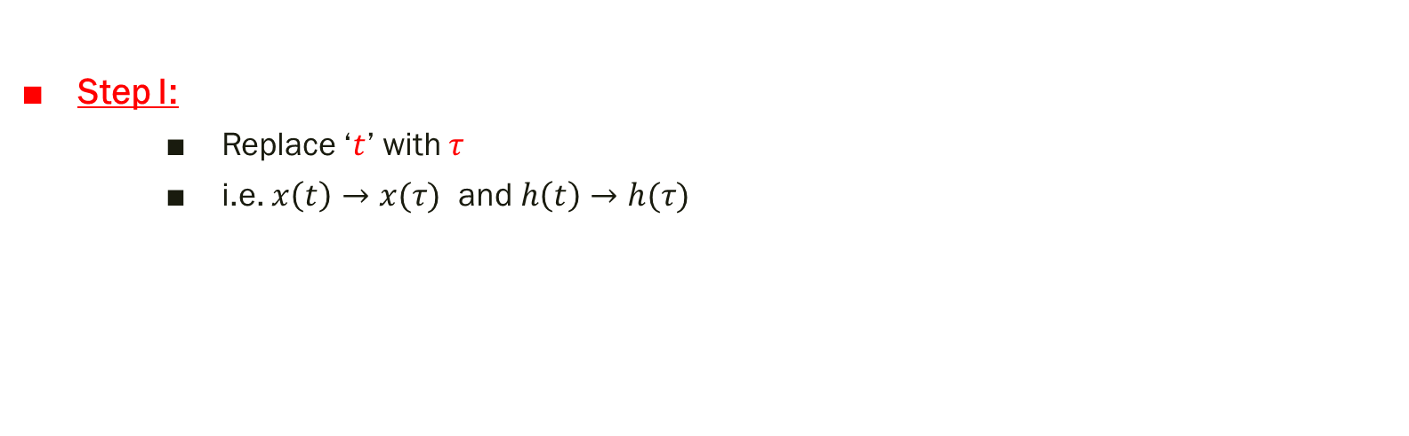
Step I:
Replace ‘$t$’ with $τ$
i.e. $x\left(t\right)→x(τ)$ and $h\left(t\right)→h(τ)$

Slide 8



Step II:
Fold $h(τ)$ and convert it into $h\left(−τ\right)$
Step III:
Advance the signal $h\left(−τ\right)$ towards left such that it converts into $h(−τ+t)$

Slide 9
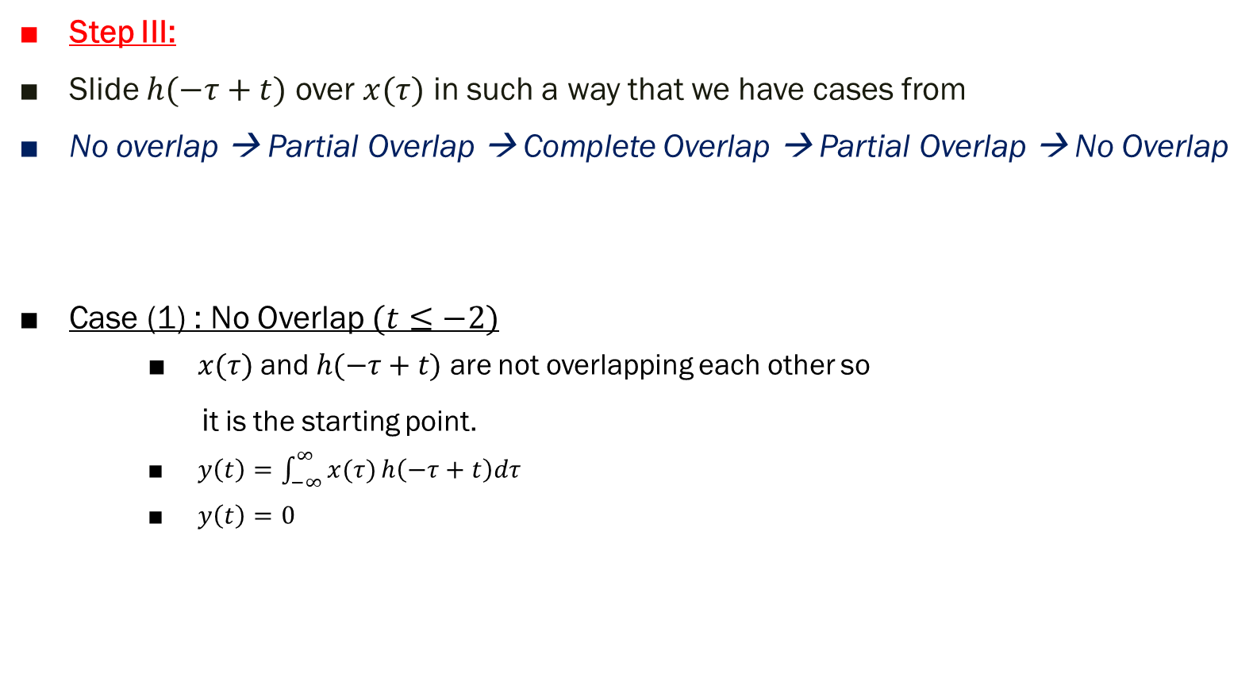
Step III:
Slide $h(−τ+t)$ over $x(τ)$ in such a way that we have cases from
No overlap → Partial Overlap → Complete Overlap → Partial Overlap → No Overlap
Case (1) : No Overlap $(t≤−2)$
$x(τ)$ and $h(−τ+t)$ are not overlapping each other so
it is the starting point.
$y\left(t\right)=\int_{−∞}^{∞}{x(τ)}h\left(−τ+t\right)dτ$
$y\left(t\right)=0$

Slide 10

Case (2) : Partial Overlap $(−2≤t≤0)$
$h(−τ+t)$ will slightly move towards right and some portion of $h(−τ+t)$ will start overlapping with $x(τ)$
$y\left(t\right)=\int_{−∞}^{∞}{x(τ)}h\left(−τ+t\right)dτ$
$y\left(t\right)=\int_{−2}^{t}{(2}.4)dτ$
$y\left(t\right)=\int_{−2}^{t}{(8})dτ$
$y\left(t\right)=8τ\left|\begin{matrix}t \\ −2\end{matrix}\right.$
$y\left(t\right)=8\left(t−\left(−2\right)\right)$
$y\left(t\right)=8\left(t+2\right)$

Slide 11

Case (3) : Complete Overlap $(0≤t≤2)$
$h(−τ+t)$ will slightly move towards right and complete portion of $h(−τ+t)$ will start overlapping with $x(τ)$
$y\left(t\right)=\int_{−∞}^{∞}{x(τ)}h\left(−τ+t\right)dτ$
$y\left(t\right)=\int_{t−2}^{t}{(2}.4)dτ$
$y\left(t\right)=\int_{t−2}^{t}{(8})dτ$
$y\left(t\right)=8τ\left|\begin{matrix}t \\ t−2\end{matrix}\right.$
$y\left(t\right)=8\left(t−t+2\right)$
$y\left(t\right)=8\left(2\right)=16$

Slide 12

Case (IV) : Partial Overlap $(2≤t≤4)$
$h(−τ+t)$ will slightly move towards right and partial portion of $h(−τ+t)$ will be overlapping with $x(τ)$
$y\left(t\right)=\int_{−∞}^{∞}{x(τ)}h\left(−τ+t\right)dτ$
$y\left(t\right)=\int_{t−2}^{2}{(2}.4)dτ$
$y\left(t\right)=\int_{t−2}^{2}{(8})dτ$
$y\left(t\right)=8τ\left|\begin{matrix}2 \\ t−2\end{matrix}\right.$
$y\left(t\right)=8\left(2−t+2\right)$
$y\left(t\right)=8\left(4−t\right)$

Slide 13

Case (IV) : No Overlap $(t≥4)$
$x(τ)$ and $h(−τ+t)$ are not overlapping each other so it is the ending point.
$y\left(t\right)=\int_{−∞}^{∞}{x(τ)}h\left(−τ+t\right)dτ$
$y\left(t\right)=0$

Slide 14

Thus,
$y\left(t\right)=\left\{\begin{aligned}\begin{matrix}0 & for t≤−2\end{matrix} \\ \begin{matrix}8(t+2) & for −2≤t≤0\end{matrix} \\ \begin{matrix}16 & for 0≤t≤2 \\ 8(4−t) & for 2≤t≤4 \\ 0 & for t>4\end{matrix}\end{aligned}\right.$

Slide 15
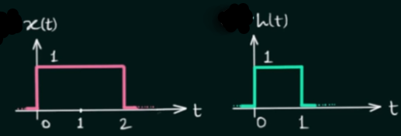

Exp 2: Evaluate $x(t)$ and $h(t)$ by graphical/ formula technique

Slide 16
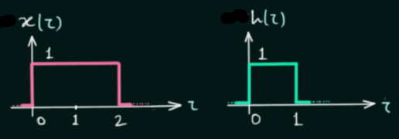

Step I:
Replace ‘$t$’ with $τ$
i.e. $x\left(t\right)→x(τ)$ and $h\left(t\right)→h(τ)$

Slide 17
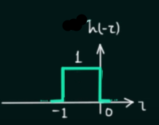

Step II:
Fold $h(τ)$ and convert it into $h\left(−τ\right)$

Slide 18
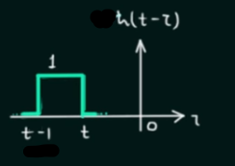

Step III:
Advance the signal $h\left(−τ\right)$ towards left such that it converts into $h(−τ+t)$

Slide 19
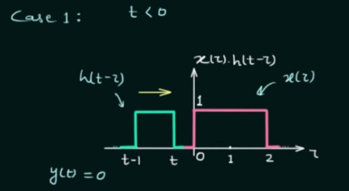
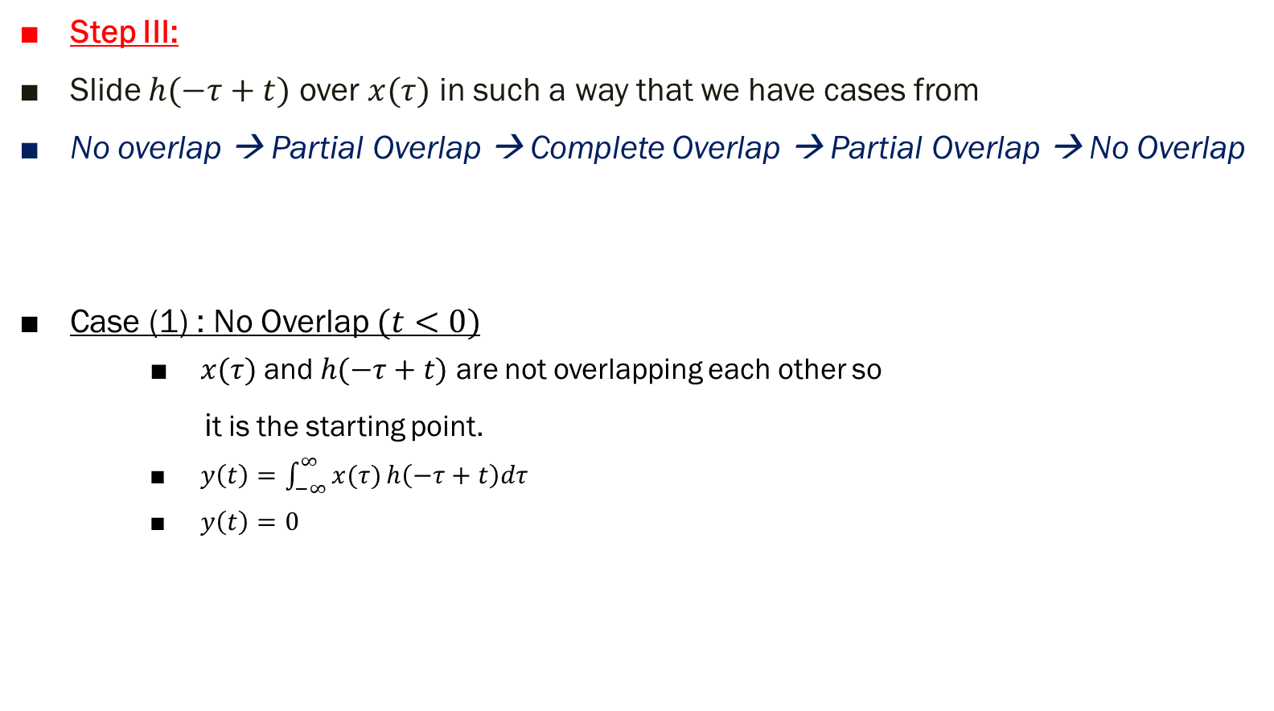
Step III:
Slide $h(−τ+t)$ over $x(τ)$ in such a way that we have cases from
No overlap → Partial Overlap → Complete Overlap → Partial Overlap → No Overlap
Case (1) : No Overlap $(t<0)$
$x(τ)$ and $h(−τ+t)$ are not overlapping each other so
it is the starting point.
$y\left(t\right)=\int_{−∞}^{∞}{x(τ)}h\left(−τ+t\right)dτ$
$y\left(t\right)=0$

Slide 20
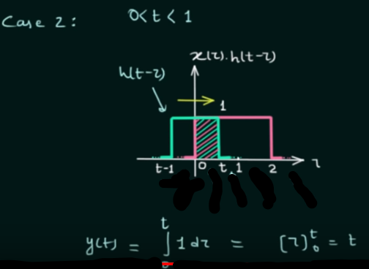

Case (2) : Partial Overlap $(0<t<1)$
$h(−τ+t)$ will slightly move towards right and some portion of $h(−τ+t)$ will start overlapping with $x(τ)$

Slide 21
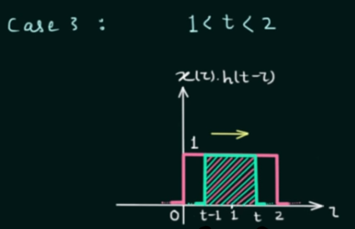
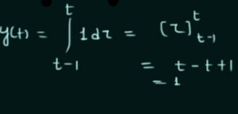

Case (3) : Complete Overlap $(1≤t≤2)$
$h(−τ+t)$ will slightly move towards right and complete portion of $h(−τ+t)$ will start overlapping with $x(τ)$

Slide 22
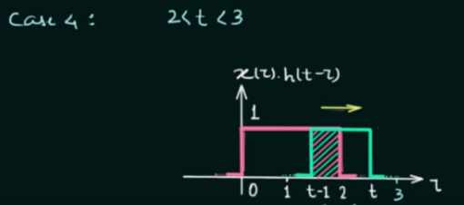

Case (IV) : Partial Overlap $(2<t<3)$
$h(−τ+t)$ will slightly move towards right and partial portion of $h(−τ+t)$ will be overlapping with $x(τ)$
$y\left(t\right)=\int_{−∞}^{∞}{x(τ)}h\left(−τ+t\right)dτ$
$y\left(t\right)=\int_{t−1}^{2}{(1}.1)dτ$
$y\left(t\right)=\int_{t−1}^{2}{(1})dτ$
$y\left(t\right)=τ\left|\begin{matrix}2 \\ t−1\end{matrix}\right.$
$y\left(t\right)=\left(2−t+1\right)$
$y\left(t\right)=\left(3−t\right)$

Slide 23
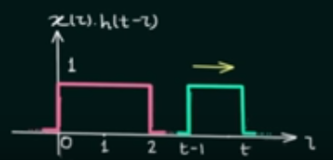

Case (IV) : No Overlap $(t>3)$
$x(τ)$ and $h(−τ+t)$ are not overlapping each other so it is the ending point.
$y\left(t\right)=\int_{−∞}^{∞}{x(τ)}h\left(−τ+t\right)dτ$
$y\left(t\right)=0$

Slide 24

Thus,
$y\left(t\right)=\left\{\begin{aligned}\begin{matrix}0 & for t<0\end{matrix} \\ \begin{matrix}t & for 0<t<1\end{matrix} \\ \begin{matrix}1 & for 1<t<2 \\ 3−t & for 2<t<4 \\ 0 & for t>3\end{matrix}\end{aligned}\right.$

Slide 25
PP. 1: Find the convolution of the following two signals

Slide 26
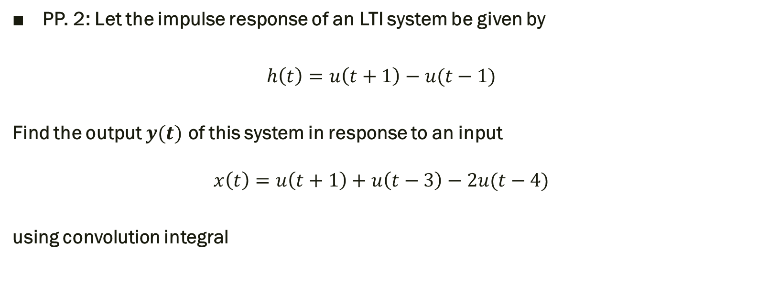
PP. 2: Let the impulse response of an LTI system be given by
$$h\left(t\right)=u\left(t+1\right)−u(t−1)$$
Find the output $y(t)$ of this system in response to an input
$$x\left(t\right)=u\left(t+1\right)+u\left(t−3\right)−2u(t−4)$$
using convolution integral

Slide 27
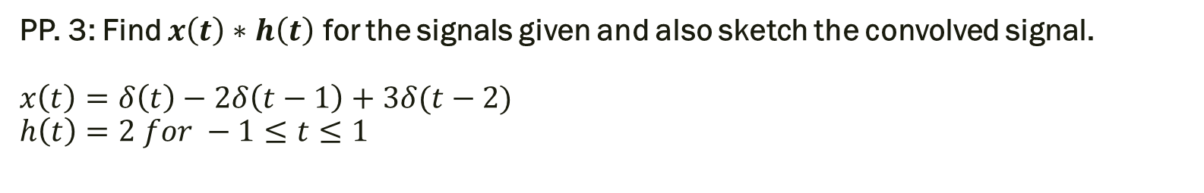
PP. 3: Find $x\left(t\right)∗h\left(t\right)$ for the signals given and also sketch the convolved signal. $x\left(t\right)=δ\left(t\right)−2δ\left(t−1\right)+3δ(t−2)$ $$h\left(t\right)=2 for −1≤t≤1$$

Slide 28
Thank You !!!

